Slide 1
2026 School Planning

Slide 2
2026 School Planning
Welcome
Agenda
    Presentation
    Q & A
    Gather feedback
    Meeting evaluation

Slide 3
2026 School Planning
The purpose of this meeting is to:
  Share information about school planning at Stanley Jones School
  Gather feedback that may be considered in making future school planning decisions

Slide 4

Notes:
What is School Planning?
This video was developed to provide you with more information about the school planning process.
https://www.youtube.com/watch?v=DrYFhZjwaxo

Slide 5
How is Our School Development Plan (SDP) Used?
Guides ongoing assessment and review of goals and actions.
Our school development plan is the driver for closing learning gaps and informs:
    Instructional strategies
    Professional learning
    School structures and processes for learning
    Resources to improve student learning
    Data-informed decision making
Notes:
Establishing and posting the plan is just the beginning. Staff work throughout the year to implement the actions and achieve the goals identified in the school development plan. Part of that work is also making sure actions are visible to the school community, including parents. Throughout the year, the school development plan will inform many aspects of our work, such as:
Instructional strategies
Professional learning
School structures and processes for learning
Resources to improve student learning
Data-informed decision making

Slide 6
School Development Plan (SDP) Goal

Slide 7
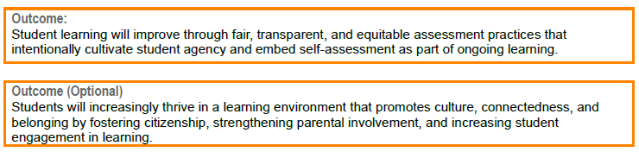
School Development Plan (SDP) Outcomes

Slide 8
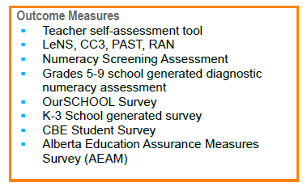
School Development Plan (SDP)
Outcome Measures
Grades 4 - 9
Grades 5 - 9
Grades 4 and 7: students, parents, teachers
LeNS: Letter Name and Sound Test: Kinder, Grade 1*, Grade 2, Grade 3
CC3: the Castles and Coltheart Reading Test 3: Grade 1*, Grade 2, Grade 3
PAST: Phonological Awareness Screen Test: Kinder, Grade 1*
RAN: Rapid Automatized Naming (Digits test): Kinder, Grade 1*
*Grade one doing the Acadience Testing this year: intervention support

Slide 9
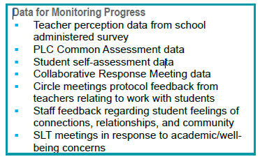
School Development Plan (SDP)
Data for Monitoring Progress

Slide 10
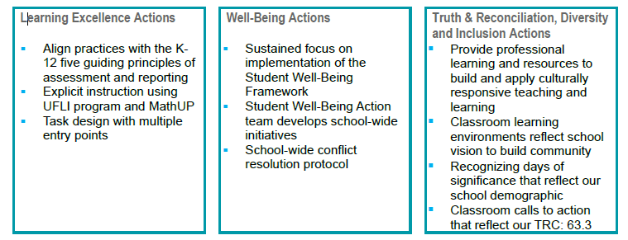
School Development Plan (SDP) Actions

Slide 11
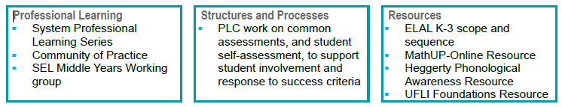
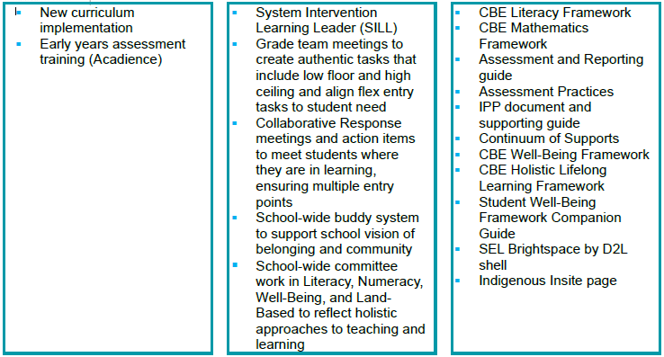
School Development Plan (SDP) Actions

Slide 12
Questions?
We’ll take a few minutes to answer questions about our school development plan.
Notes:
Pause at this slide until your Q&A is finished.
You may want to remind participants that this Q&A is to clarify anything that was unclear in the presentation up to this point and that there will be an opportunity to provide feedback after the presentation.

Slide 13
Our School Budget
Our school received $3,164,137 in 2025-26 to provide a quality education to our students and meet the goals in our school development plan (SDP).
At least 75 per cent of budgeted funds covers staffing and the remaining portion covers instructional and operational supplies.
Notes:
Most aspects of a school development plan are independent of the school budget. However, budget may affect how we implement a school development plan. For instance, if a school development plan identifies English language learning as the focus, the school could elect to allocate part of their budget to hiring a teacher to support English language learners and build teacher capacity in this area. In other cases, schools may also consider parent fundraising to enrich supports currently available (e.g., expand the collection of dual language books in the school’s learning commons).
The vast majority of funding goes to staffing. The remaining portion pays for supplies and other resources.

Slide 14
Our 2025-26 School Budget
Our student enrolment for the current year is 436.
RAM Allocations
Per School Total |  | $ 692,380
Per Student Total |  | $ 2,471,757
Total RAM Allocations |  | $ 3,164,137
RAM Deployment | Scenario A
Organization |  | FTEs
Teachers | $ $2,647,086 | 23.3
Support Staff | $ $271,298 | 4.6
Administration | $ $141,958 | 2.3
Total Staffing | $ $3,060,342 | 30.2
Supplies/Other | $ $103,795
Total RAM Deployment Plans | $ $3,164,137
Notes:
Total RAM comprised of:
Per Student Total: funding per student, which covers most of the cost of teacher staffing
Per School Total: additional funding to cover contract absences (teacher/support staff subs), P/AP/LL allowances, Kinder Discretionary funding/CBRF to hire additional Support Staff, sub coverage funding for teacher assessments, money for bookkeeper.

Slide 15
Our 2025-26 School Fees
We will consult with families by outlining proposed activities for the upcoming year that may require a fee for cost recovery.
  Field Trips
  Transportation for Field Trips
  Artist in Residence
  Guest Speakers/Presenters
  CTF/FPA (options)
  Athletics/Tournaments
  Extra Curricular Clubs
Notes:
You may want to discuss some of the following topics:
How fees, fundraising and budget are interconnected.​
How parent society fundraising $s were used to lower/eliminate some fees​
What the major categories of fees were at the school​
School-based fees vs. central CBE fees (e.g., transportation, noon supervision, school supplies)​
Differences when compared with last year’s school fees

Slide 16
Our 2025-26 School Fees
§Guide to 2025-26 School Fees
Notes:
This is the list of approved school fees for 2025-26. In August, the fees for the 2026-27 school year will be posted.
School fees are only charged to cover the cost of an activity. Based on what we know at this time, fees for 2026-27 will be similar to what you see for this year. You may see an increase in fees where the cost of an activity (or a material associated with the activity) has increased.

Slide 17
Our 2025-26 School Fees
2024-25 Report to Parents on Fees

Slide 18
Questions?
We will take a few minutes to answer questions about our school budget and fees.
Notes:
Pause at this slide until your Q&A is finished.
You may want to remind participants that this Q&A is to clarify anything that was unclear in the presentation up to this point and that there will be an opportunity to provide feedback.
It is recommended that someone keeps time.

Slide 19
Gathering Your Feedback
Feedback is important as we consider school planning. When students, families and staff work closely together, students achieve greater success in their learning.
We would now like to gather your feedback on some specific questions.
Notes:
Please provide your comments and thoughts.
TIP: Have someone take notes to capture comments and feedback.

Slide 20
Gathering Your Feedback
School Development Plan (SDP)
We share SDP information and updates in different ways. In what ways have you learned about our SDP?
School website
School council meeting
Individual Conversations
Other
Notes:
Explain the methods used to share SDP information and updates with parents.

Slide 21
Gathering Your Feedback
School Development Plan (SDP)
The SDP is developed with all students in mind. Do you agree that:
Your child's learning can benefit from the goal, outcomes, actions and resources in the SDP?

Slide 22
Gathering Your Feedback
School Development Plan (SDP)
The SDP is developed with all students in mind. Do you agree that:
The learning of all students is reflected and prioritized in the goal, outcomes, actions and resources in the SDP?

Slide 23
Gathering Your Feedback
School Budget & Fees
Schools must operate within their budget, and too many fees can be unmanageable for families. Knowing that, what activities and services are most important to you?
  Curricular Enhancement Materials (i.e. Science lab material, PE equipment, student technology)
  Field Trips
  Transportation for Field Trips
  Artist in Residence
  Guest Speakers/Presenters
  CTF/FPA (options grades 7-9)
  Athletics/Tournaments
  Extra Curricular Clubs

Slide 24
Gathering Your Feedback
School Budget & Fees
Do you agree that:
The activities our school provides (e.g., field trips, guest speakers, experts in schools, sporting activities, outdoor education, etc.) are important for your child's learning?
The school fees you pay are reasonable considering the benefit they provide your child?

Slide 25
Wrap-Up
Thank you for your participation.
Please take a few minutes to share your feedback about this meeting.
Notes:
We want to make sure our meetings meet your needs and expectations. That's why we are asking for your feedback on this meeting. Your feedback is the only way we will know what we're doing well and what we can improve at future meetings. So please do take a few minutes to share your feedback. We will share a summary of responses on our website later this spring.

